Slide 1
Next Up:
Anam Navied

Slide 2
3
3

Slide 3
2

Slide 4
1

Slide 5
PSResourceGet: Enhancing Trust in the Supply Chain with Container Registry Galleries
Anam Navied

Slide 6

Many thanks to our sponsors:

Slide 7

Anam Navied
Software Engineer 2 on the PowerShell team
Work on PSResourceGet, PSGallery, Security
First PSConfEU!

Slide 8
PSResourceGet Introduction
Package manager for find, install and publish PowerShell resources (scripts, modules) from repositories

Slide 9
PSResourceGet Introduction
Package manager for find, install and publish PowerShell resources (scripts, modules) from repositories
PowerShellGet v2 (2.x and below)
Install-Module
Find-Module

Slide 10
PSResourceGet Introduction
Package manager for find, install and publish PowerShell resources (scripts, modules) from repositories
PowerShellGet v2 (2.x and below)
PSResourceGet
Install-Module
Find-Module
Install-PSResource
Find-PSResource

Slide 11
PSResourceGet Introduction
Package manager for find, install and publish PowerShell resources (scripts, modules) from repositories
PowerShellGet v2 (2.x and below)
PowerShellGet v3 (3.x and above)
PSResourceGet
Install-Module
Find-Module
Install-PSResource
Find-PSResource

Slide 12
PSResourceGet Introduction
Package manager for find, install and publish PowerShell resources (scripts, modules) from repositories
PowerShellGet v2 (2.x and below)
PowerShellGet v3 (3.x and above)
PSResourceGet
Install-Module
Find-Module
Install-PSResource
Find-PSResource

Slide 13
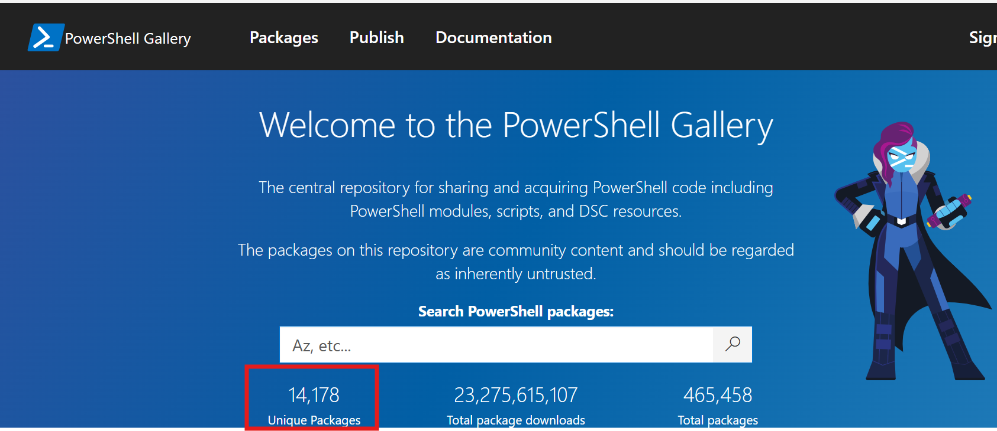
PowerShellGallery Introduction
Default repository
Untrusted repository- community and enterprise packages present!
Scenarios:
Resource discovery
CI workflows

Slide 14
Package Consumption Challenges
Determining package trust
Availability and reliability
Share packages privately
Supporting air gapped scenario
Integration with Azure resources
Notes:
Challenges wrt to PowerShellGallery

Slide 15
Container Registry
Registry
✅ OCI standard
Azure Container Registry (ACR)
Image
.nupkg file
Artifact
Artifact
Artifact

Slide 16
Terminology
ACR
PSResourceGet
Registry
Repository
Repository
Package
Tag
Version
Package keyword
Tag

Slide 17
Demos

Slide 18
ACR: Permissions with RBAC
Public feed
Private feed
Grant permissions with RBAC:
AcrPull
AcrPush
AcrDelete
Owner

Slide 19
Demos

Slide 20
ACR: Authentication
Authentication required for operation on repository
Interactive auth
Connect-AzAccount
Login window
Non-interactive auth
Stored credentials via SecretManagement

Slide 21
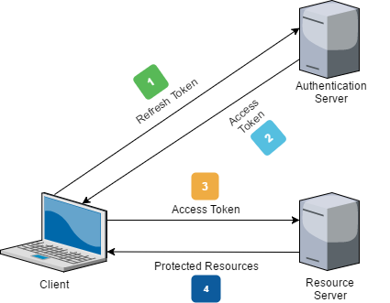
Deep dive: Authentication
5
Refresh Token
Token based
authentication
1
Login with AAD
2
Access Token + Refresh Token
3
Access Token
4
Resources

Slide 22
Deep dive: ORAS APIs
REST calls to ACR with OCI spec APIs
Leverage ORAS (OCI Registry as Storage)
Recently released .NET SDK
Extend PSResourceGet’s support for other OCI compliant container registries
https://github.com/opencontainers/image-spec

Slide 23
Why should you use ACR?
Privacy
Trust
More secure
Availability and reliability (99.9% SLA)
Authentication
Upstream sources
Integration with other Azure resources

Slide 24
Integration with MAR
Microsoft Artifact Registry
Official registry for Microsoft images and artifacts
Read only repository (unless you’re a Microsoft team)
Search for ‘psresource’
Benefits:
Trust
Better reliability
Az modules are live on MAR!

Slide 25
Demos

Slide 26

Central Repository solution
ACR
MAR
PSResourceGet
PSResourceGet

Slide 27
Central Repository solution
ACR
MAR
MAR
ACR
PSResourceGet
PSResourceGet
PSResourceGet

Slide 28
Demos

Slide 29
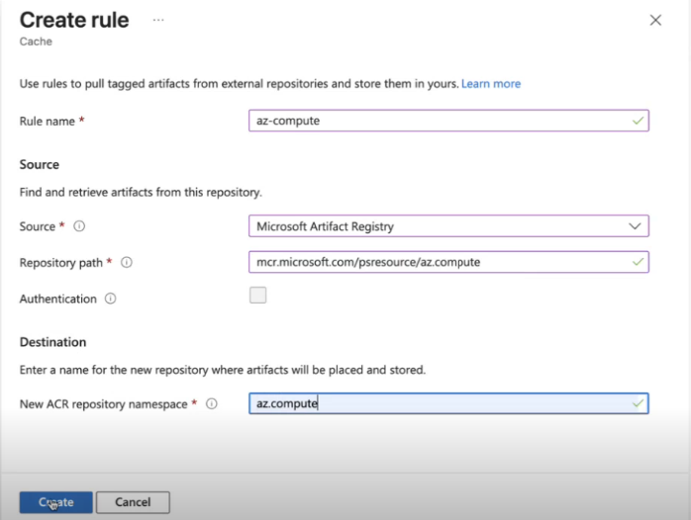
Expected Results
1
Notes:
Demo caching rule for MAR – had screenshots bc the demo gods were unhappy

Slide 30
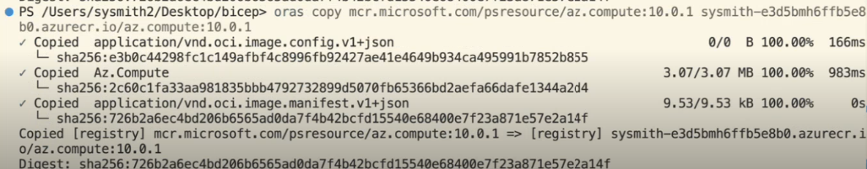
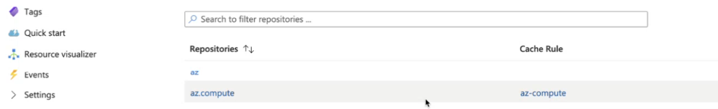
Expected Results
2
3

Slide 31
Why ACR with upstream MAR?
Improved trust and security
Better reliability for consuming essential packages
More secure
Air gapped solution
Integration with Azure Management services, Azure security services and Azure access control

Slide 32
Future work
More Microsoft modules coming soon to MAR!
MAR = “Trusted repository for all Microsoft owned PSResources/packages”
Cmdlet support for initial upstream pull
Cache support (faster installations)
Tagging packages and tag search to discover security
Unlisting

Slide 33
Key Takeaways
ContainerRegistries like ACR provide a secure private gallery
PSGallery is an untrusted repository!
MAR, Microsoft’s trusted source of artifacts, will soon be the trusted feed for all Microsoft owned PSResources
ACR registry with MAR upstream -> central repository solution for your supply chain

Slide 34
Get involved!
To onboard to ACR: aka.ms/psgetACR
To onboard to MAR as a user: aka.ms/psgetMAR
To onboard to MAR as a Microsoft team: reach out!
Bugs, feature requests: https://github.com/PowerShell/PSResourceGet

Slide 35
Q&A
15 minutes

